Slide 1

How to visualize?

Slide 2
Ch 5: Marks & Channels

Slide 3


Definitions: Marks and channels
marks
– geometric primitives
Points
Lines
Areas
Position
Horizontal
Color
channels
– control appearance of marks
Vertical
Both
Shape
Tilt
Size
Length
Area
Volume

Slide 4







Encoding visually with marks and channels
analyze idiom structure
– as combination of marks and channels
1:
vertical position
2:
vertical position horizontal position
3:
vertical position horizontal position color hue
4:
vertical position horizontal position color hue
size (area)
mark: point
mark: line
mark: point
mark: point

Slide 5







Channels
: Expressiveness types and effectiveness rankings
annels: Ordered Attributes Identity Channels: Categorical Attributes
Magnitude Ch
Position on common scale
Spatial region
Position on unaligned scale
Color hue
Length (1D size)
Motion
Tilt/angle
Shape
Area (2D size)
Depth (3D position)
Color luminance
Color saturation
Curvature
Volume (3D size)

Slide 6

Channels: Rankings
Magnitude Channels: Ordered Attributes
Position on common scale
Position on unaligned scale Length (1D size)
Tilt/angle Area (2D size)
Depth (3D position) Color luminance Color saturation Curvature
Identity Channels: Categorical Attributes
Spatial region
Color hue
Motion
Shape
effectiveness principle
– encode most important attributes with highest ranked channels
expressiveness principle
– match channel and data characteristics
Volume (3D size)

Slide 7
Weber Law
The Weber–Fechner law refers to two related hypotheses in the field of psychophysics, known as Weber's law and Fechner's law. Both laws relate to human perception, more specifically the relation between the actual change in a physical stimulus and the perceived change. This includes stimuli to all senses: vision, hearing, taste, touch, and smell.

Slide 8




















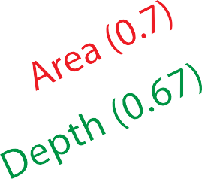









Accuracy: Fundamental Theory
13
Notes:
is an empirical relationship in psychophysics between an increased intensity or strength in a physical stimulus and the perceived magnitude increase in the sensation created by the stimulus. It is often considered to supersede the Weber–Fechner law, based on a logarithmic relationship between stimulus and sensation, because the power law describes a wider range of sensory comparisons.

Slide 9


















Accuracy:Vis experiments
Cleveland & McGill’s Results
Positions
1.0
1.5
2.0
Log Error
2.5
3.0
Crowdsourced Results
Angles
Circular areas
[Crowdsourcing Graphical Perception: Using Mechanical Turk to Assess Visualization Design.
Heer and Bostock. Proc ACM Conf. Human Factors in Computing Systems (CHI) 2010, p. 203–
212.]
Rectangular
areas
(aligned or in a
treemap)
1.0
1.5
2.0
Log Error
2.5
3.0
after Michael McGuffin course slides, http://profs.etsmtl.ca/mmcguffin/
14

Slide 10





































Separability vs. Integrality
Position
Hue (Color)
Size
Hue (Color)
Width
Height
Red
Green
Fully separable
Some interference
Some/significant interference
3 groups total: integral area
Major interference
2 groups each
2 groups each
4 groups total: integral hue

Slide 11






Popout
find the red dot
how long does it take?
parallel processing on many individual channels
speed independent of distractor count
speed depends on channel and amount of difference from distractors
serial search for (almost all) combinations
speed depends on number of distractors

Slide 12














Popout
many channels: tilt, size, shape, proximity, shadow direction, ...
but not all! parallel line pairs do not pop out from tilted pairs

Slide 13






Grouping
Marks as Links Containment
Connection
containment
connection
Identity Channels: Categorical Attributes
proximity
same spatial region
similarity
same values as other categorical channels
Spatial region
Color hue
Motion
Shape

Slide 14
Relative vs. absolute judgements
perceptual system mostly operates with relative judgements, not absolute
that’s why accuracy increases with common frame/scale and alignment
Weber’s Law: ratio of increment to background is constant
filled rectangles differ in length by 1:9, difficult judgement
white rectangles differ in length by 1:2, easy judgement
B
B
A
length
A
position along unaligned common scale
A B
position along aligned scale
after [Graphical Perception:Theory, Experimentation, and Application to the Development of Graphical Methods. Cleveland and McGill. Journ. American Statistical Association 79:387 (1984), 531–554.]

Slide 15
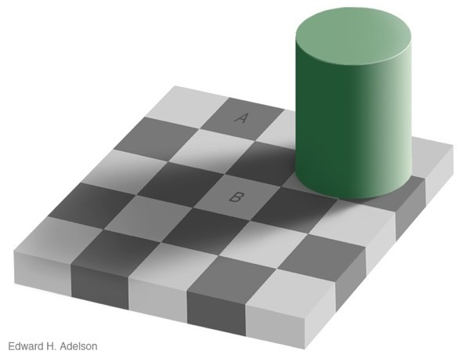
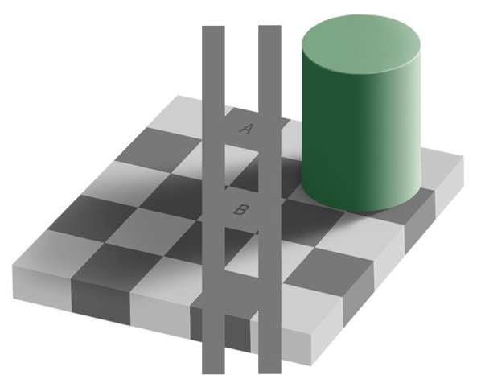
Relative luminance judgements
perception of luminance is contextual based on contrast with surroundings
http://persci.mit.edu/gallery/checkershadow

Slide 16
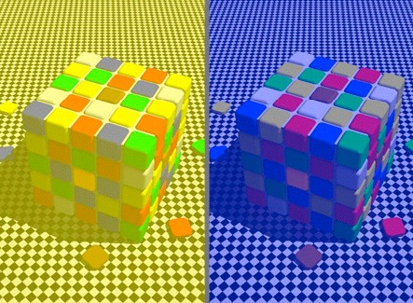
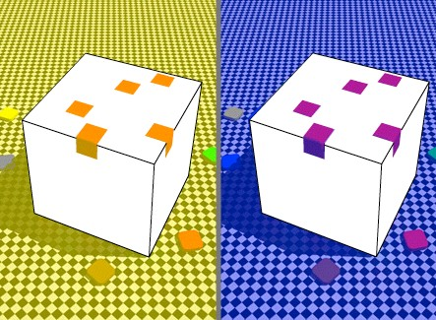
Relative color judgements
color constancy across broad range of illumination conditions
http://www.purveslab.net/seeforyourself/
22

